Slide 1



ABAP on Hana s/4 Hana Training
Day 4
contact@anubhavtrainings.com

Slide 2

Agenda – Day 4
Showing Migration to SAP HANA as well as S/4 HANA
Describing Any Database Migration to HANA Database
SCI ( SAP Code Inspector )
ATC ( ABAP Test Cockpit )
S/4HANA Code Conversion

Slide 3
Migration to HANA
A
B
C
ABAP
Business Suite
ABAP S/4HANA
ABAP
Non HANA
Any DB
HANA
HANA
Our company is migrating just the database
1. Basis – just like any other DB Migration, Data provisioning of all DB tables which are client independent. SUM
As an ABAP Developer, whether the custom code written by developers will work or not?

Slide 4
Any Database to HANA Database
Native SQL statements written in old DB will not work.
EXEC SQL
SELECT ROWNUM, ORDID FROM mytab;
OPEN CURSOR…
END EXEC
01
Db specific hints supplied to SELECT Queries
‘%_HINTS MSSQLNT ‘&prefer_join0&’’
02
When we read data from DB in non-sorted form and perform a Spurious Data.
DELETE ADJUCENT DUPLICATES
READ TABLE Binary Search
03
04
Direct access to Pool and Cluster table.
05
Checks to DB specific Secondary index

Slide 5
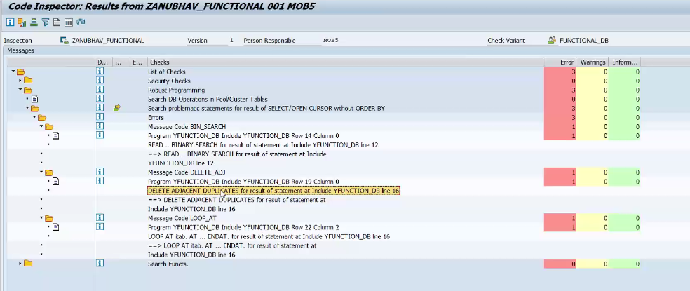
SAP Code Inspector ( SCI )
The Code Inspector is a tool for checking Repository objects. Using the Code Inspector, we can check individual objects or sets of objects for performance, security, syntax, and adherence to name conventions.

Slide 6
ABAP Test Cockpit ( ATC )
ABAP Test Cockpit (ATC) is an SAP new tool for ABAP programs quality checking. ... The ABAP Test Cockpit is directly integrated into the ABAP workbench as well as in the ABAP Development Tools for Eclipse and allows checking code from just within the development environment the ABAP developer is used to.
Syntax Check & Standard SCI Check inc. slin
SAP HANA Checks (Functional DB)
ATC
SAP S/4 HANA Check
Security Check
ABAP Unit Test

Slide 7
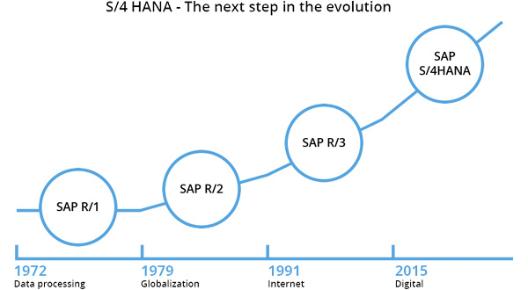
SAP ERP Evolution

Slide 8
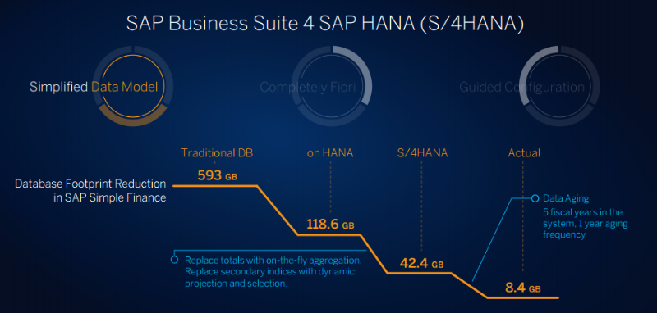
SAP ERP Evolution

Slide 9
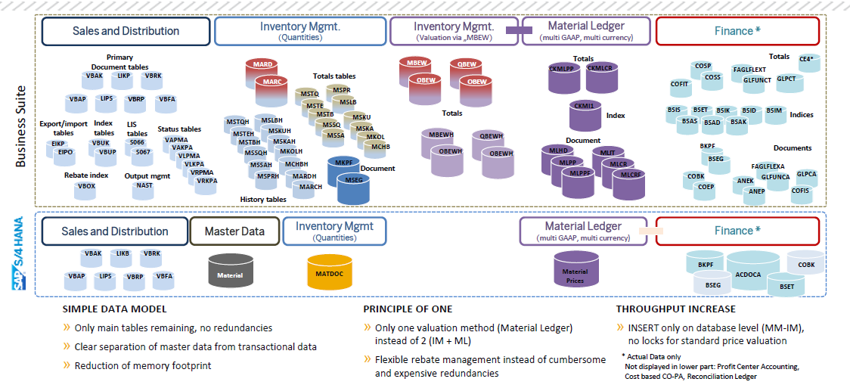
Architecture of SAP Material Table

Slide 10

What About My Custom Code

Slide 11
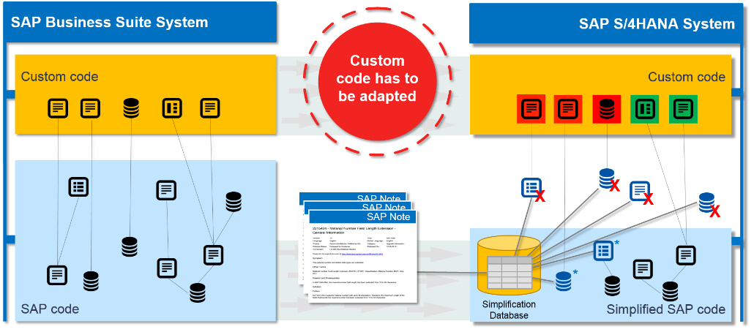
Custom Code Adaptation System

Slide 12
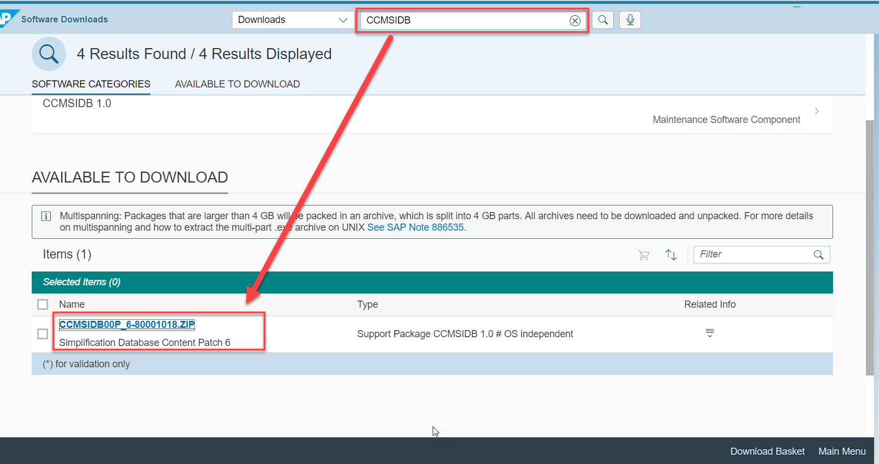
Adapting Custom Code in system

Slide 13
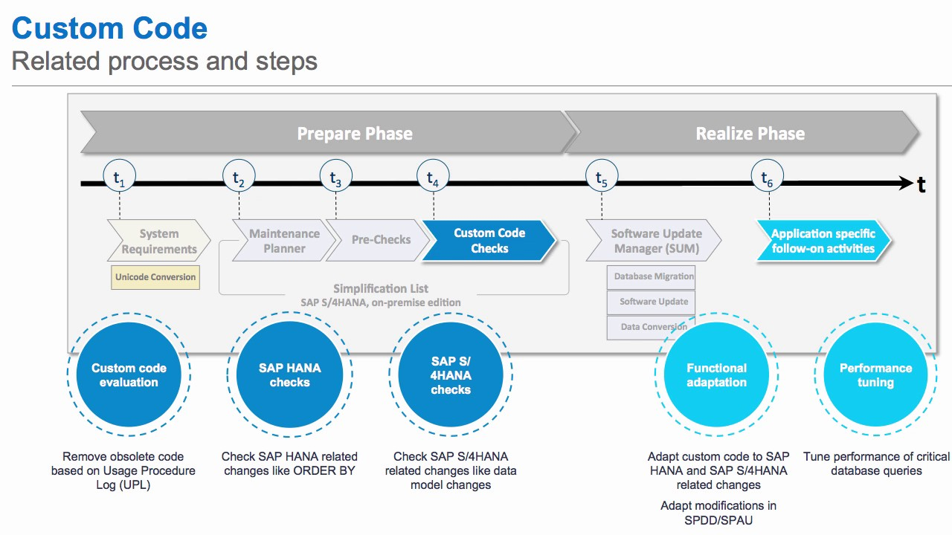
Custom Code Conversion Process
https://blogs.sap.com/2016/02/02/sap-s4hana-custom-code-migration-worklist/

Slide 14

S/4 HANA CODE Conversion
SAP S/4HANA Readiness Check: is a tool designed to assist Customers with planning and preparation activities necessary to convert an SAP ECC system to SAP S/4HANA. Customers can execute to verify different aspects of an existing SAP ERP system.
Exercise 2
Custom Code Conversion
Business Suite Incorrect Code
S/4 HANA Correct Code

Slide 15

Additional Learning
https://blogs.sap.com/2019/06/25/custom-code-adaptation-for-sap-s4hana-faq/
https://blogs.sap.com/2020/06/22/s-4hana-conversion-t2-readiness-check-2.0-step-by-step/
https://blogs.sap.com/2020/06/02/sap-readiness-check-2.0-setup-execution/
https://www.youtube.com/watch?v=-A66NASBxEk

Slide 16

End of Day 4
Trainer: Anubhav Oberoy & Shubham Singh

Slide 17

Trainer: Anubhav Oberoy & Shubham Singh

Slide 18
THANK YOU
If you cannot do
great things, do small things in a great way.
Anubhav Oberoy & Shubham Singh
https://www.anubhavtrainings.com

Slide 19


We’re committed to empower you to be
Most Desirable Resource
through powerful training solutions.
We build the workforce of the future.
250+
Corporate Clients
30,000+
Learners Trained
25000+
Learners Placed
FREE WEBINARS
Sign up for free webinars with industry experts every fortnight!
Enroll Now!
Contact us today!
https://anubhavtrainings.com/

Slide 20




More from AnubhavTrainings.com

